Slide 1
Arduino based Arfa Bot for Remote Surveillance
Alwar G ,Balaji M P ,Arun C ,Charumathy M
Rajalakshmi Engineering College, Chennai-625002
Department of Computer Science and Engineering.

Slide 2
Remote surveillance
Remote surveillance is a well known technology that is being implemented in areas that pose threat to humans where physical straying of humans in an area is required.
Mobile devices like cell-phones and tablets are playing a key role in the exponential growth of this volatile technology.
IoT’s are a trending technology in almost every field. Here by this paper we put forward to implement loT’s in agricultural surveillance systems.

Slide 3
INTRODUCTION
This project is based on Internet of Things which is being used to solve most of the problems in agriculture sector.
In the field of agriculture there are many problems to farmers.
One such problem is the farmer being attacked by animals while monitoring his yields on the field most probably during night times.
By this the farmer gets injured fatally or leading to deaths in some cases.
Thousands were injured due to this problem of animals evading the fields.

Slide 4
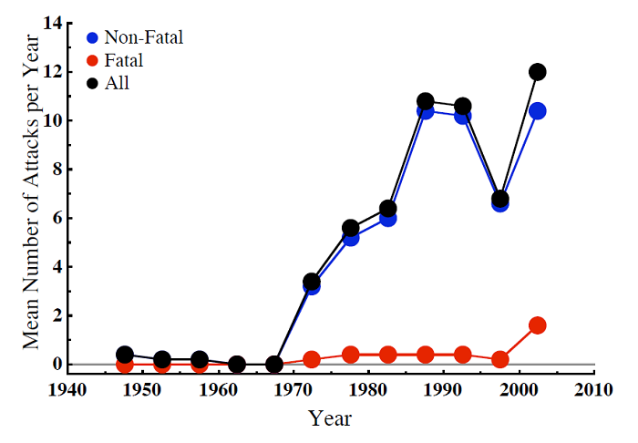
FATALITIES AND STATS
As the population in India steadily grows, there has been a corresponding increase in the loss of lives due to attack by the wild animals. The latest government figures reveal that over the past three years, one person dies on average every day due to tiger and elephant attacks.

Slide 5
Components and platforms
Arduino
Ethernet Shield
Jumper Wires
Car chassis
Arduino software
Bread board
Node.js

Slide 6
ACRONYMS AND KEYTERMS
GNU: GNU’s Not Unix .It is an operating system and an extensive collection of computer software. GNU is composed wholly of free software, most of which is licensed under the GNU Project's own GPL.
MQTT: Message Queuing Telemetry Transport is an ISO standard (ISO/IEC PRF 20922) publish-subscribe-based messaging protocol. It works on top of the TCP/IP protocol. Devices communicate only when it is required. machine-to-machine (M2M) / IoT connectivity protocol.
W5100 :The W5100 chip is a Hardwired TCP/IP embedded Ethernet controller . Users can implement the Ethernet application they need by using a simple socket program instead of handling a complex Ethernet Controller

Slide 7
Arduino
Arduino is an open source computer hardware and software company, project and user community that designs and manufactures single-board microcontrollers and microcontroller kits for building digital devices and interactive objects that can sense and control objects in the physical world.
The project's products are distributed as open-source hardware and software, which are licensed under the GNU Lesser General Public License (LGPL) or the GNU General Public License(GPL), permitting the manufacture of Arduino boards and software distribution by anyone. Arduino boards are available commercially in preassembled form, or as do-it yourself (DIY) kits.

Slide 8
Ethernet board
The Arduino Ethernet Shield allows an Arduino board to connect to the internet.
It is based on the Wiznet W5100/W5200 ethernet chip providing a network (IP) stack capable of both TCP and UDP.
Use the Ethernet library to write sketches which connect to the internet via a RJ45 Ethernet jack.

Slide 9
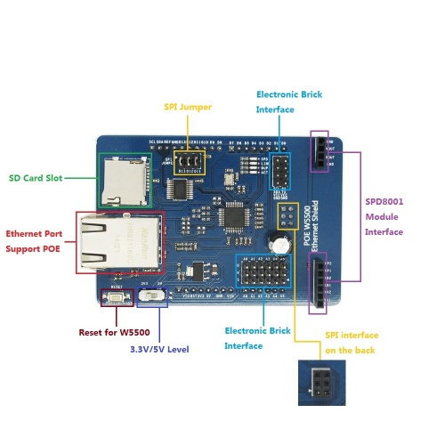
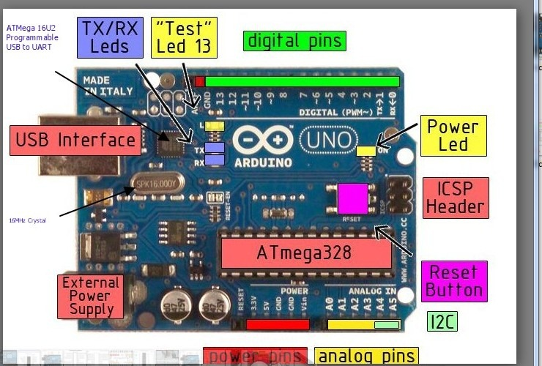
Arduino (UNO) and Ethernet Shield:

Slide 10
WORKING METHODOLOGY
Initially the arduino bot is tested using Ethernet for wired services and upon successful working it is integrated with an gsm module to connect it to the open web.
At the client end the client needs to just authenticate to the corresponding DNS referred IP address where the front end provides control over the system remotely.
GSM provides more reliable wireless communication hence can be deployed in remote parts of the country because of its wide coverage.

Slide 11
WORKING METHODOLOGY-Node.js
Node.js has been used highly off-late for deploying IoT based projects because of its simplicity and ease-of-access.
We use express module for initially deploying the application on the local server thereby allowing to easily test and run.
Socket.io maintains a live connection between the client and the server which in turn is relayed with the motobot.
HTML is used to design the user interface with the arrow keys and stop as its functionalities.
These controls are sufficiently enough for the user to efficiently control the motobot.

Slide 12
The keys provided at the UI are sufficiently enough to control the motobot remotely.
The bot is inturn configured to respond to the inputs relayed from the UI thus establishing a total control over its sensors.

Slide 13
FUTURE DEVELOPMENTS
This surveillance could be further developed to include image recognition technology to identify the objects it captures.
Thus inducing AI into the bot would mean a greater market for the bot both affordably and on the technology shelf as well.
For local connection as well this could be used where farmer could surveil his farm from at home just needing a browser to access the live footages provided by the bots.
This bot would have an AT design(All Terrain) which would not have any problems penetrating through fields.

Slide 14
CONCLUSION
In this project, a remote surveillance system has been designed successfully to avoid mishaps in the fields.
The project will be highly cost-efficient making it available to all the farming societies.
We also be using MQTT protocol for deployment.
We need not be physically be present near to the device, just a browser is what we will need to control the bot.

Slide 15
THANK YOU

